Slide 1
FOOD EXPRESS
TEAM - 2
DEVA HARSHALAI NIMMAGADDA
MURALI KRISHNA KAMARAPU
JIGAR VAISHNAV
ASMA BATOOL LALAMIAH
THARUN DONAPATI
NAVYA VEMURI
VENU YADA

Slide 2
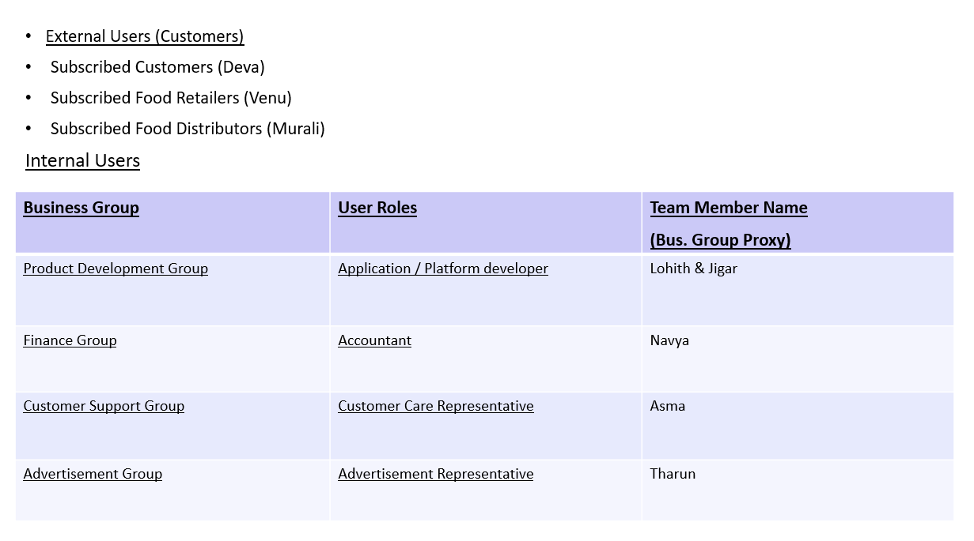
BRM DIAGRAM : USER ROLES
PRESENTED BY
-MURALI

Slide 3
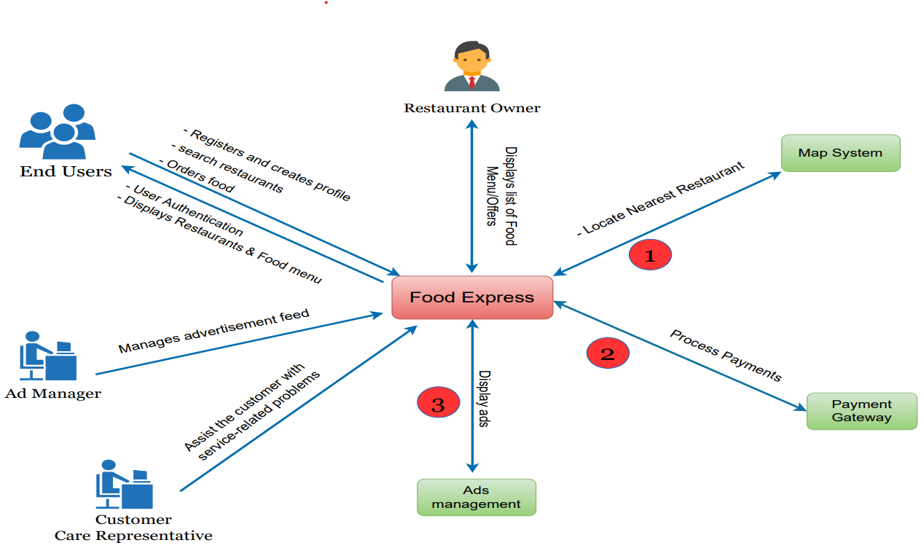
CONTEXT DIAGRAM
PRESENTED BY
- ASMA

Slide 4
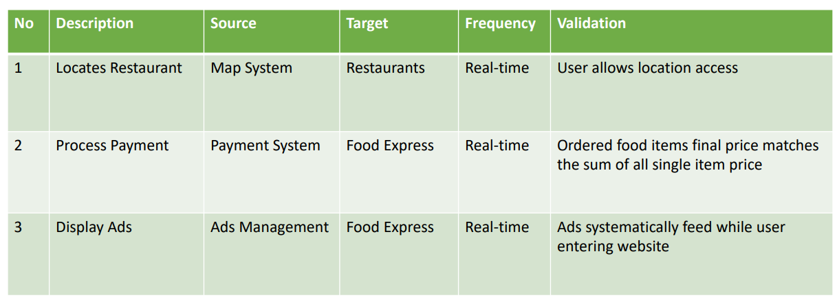
CONTEXT DIAGRAM:SYSTEM INTERFACE TABLE
PRESENTED BY
- ASMA

Slide 5
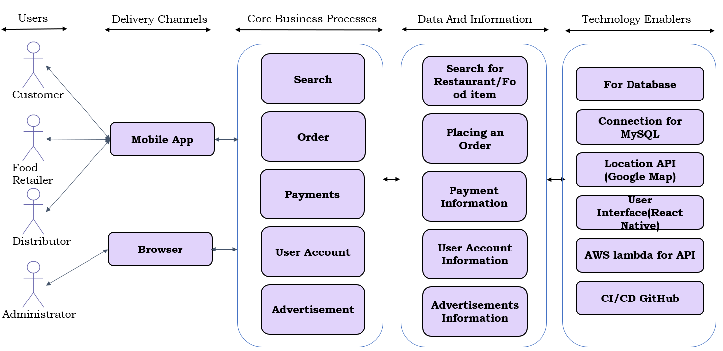
Type: Application Architecture View: Logical View Style: Layered Architecture Pattern
PRESENTED BY
- VENU

Slide 6
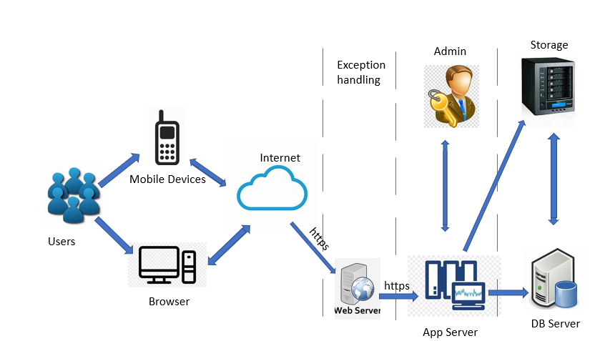
Architecture type : Application Architecture View : Process View Style : Client – Server Architecture Pattern
PRESENTED BY
- VENU

Slide 7
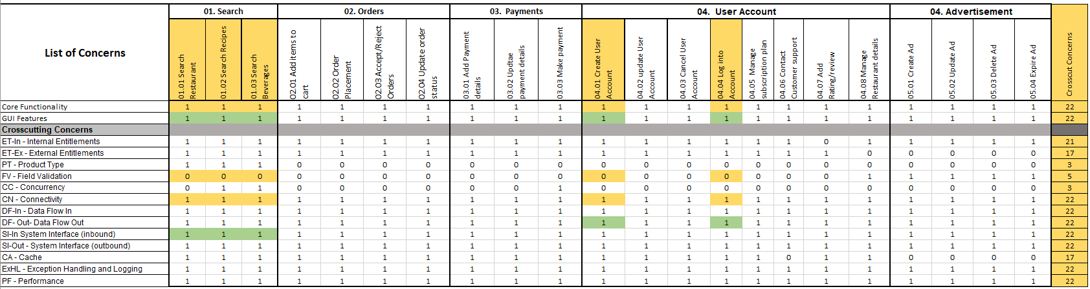
Requirements Composition Table
PRESENTED BY
- NAVYA

Slide 8
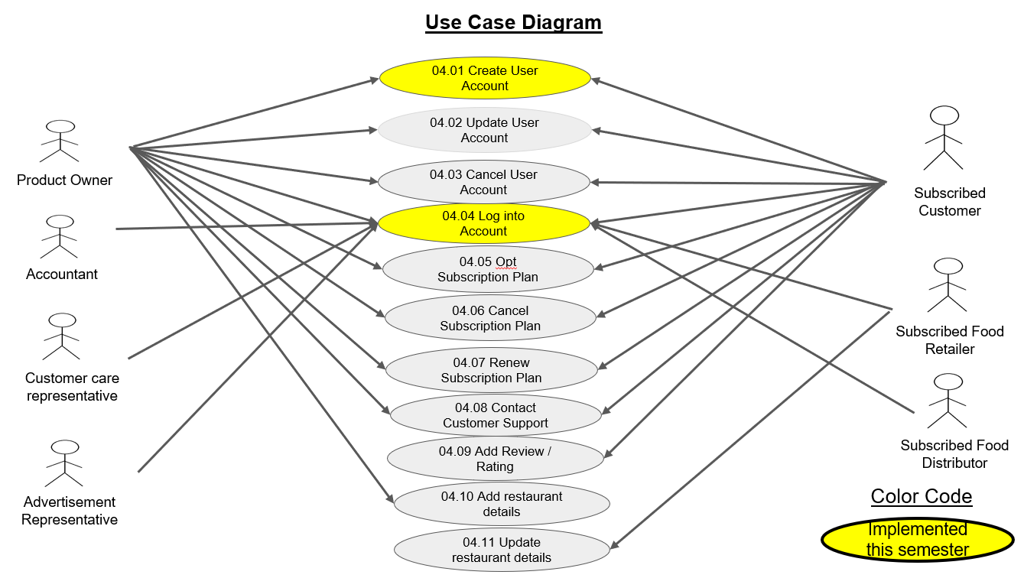
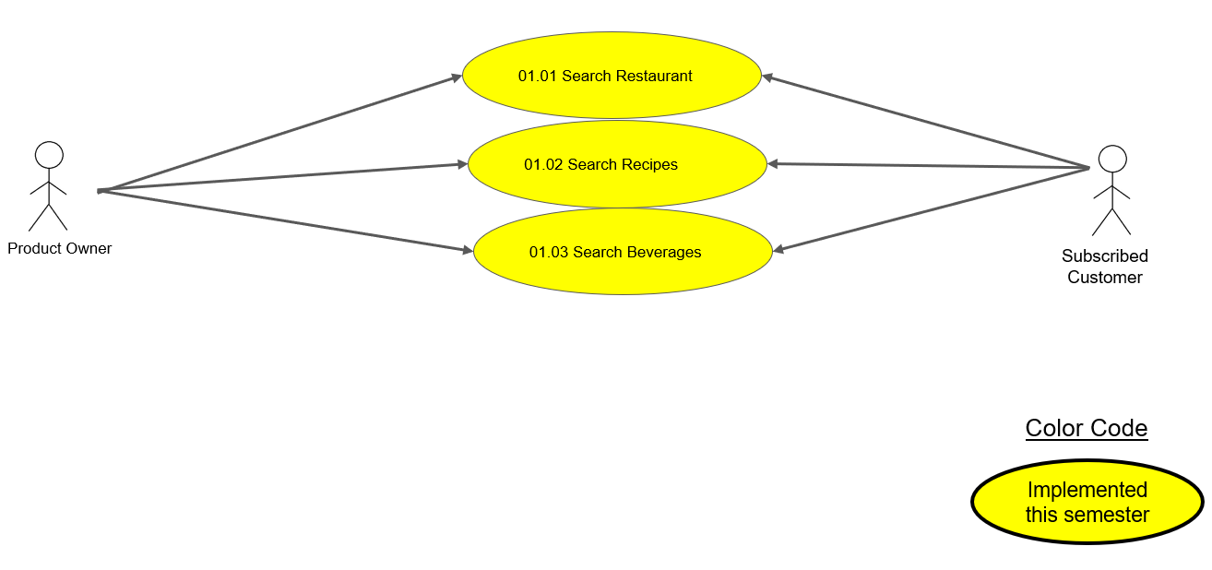
Food Express Application Use Case Diagram Module: 04. User Account
PRESENTED BY
- LOHITH

Slide 9
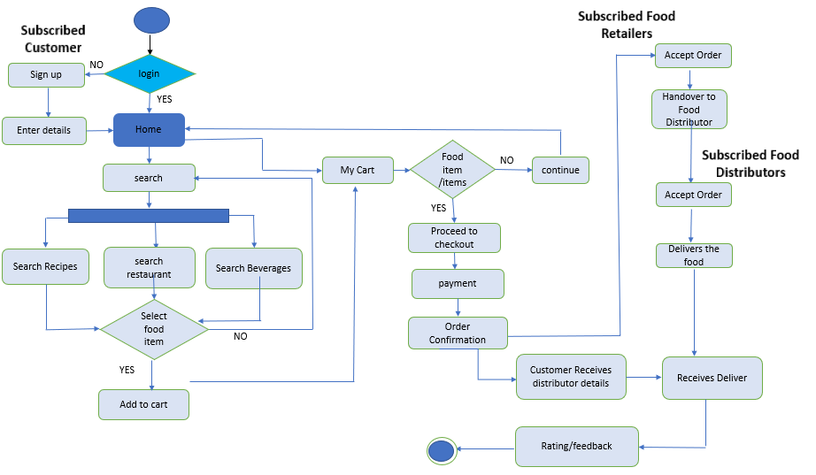
Activity Diagram – Food Express
PRESENTED BY
-THARUN

Slide 10
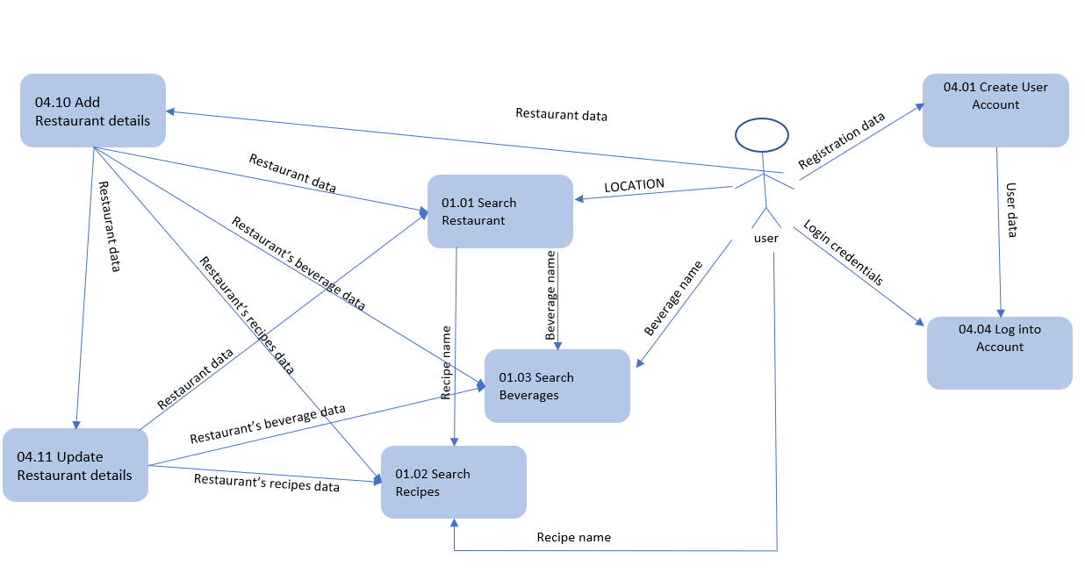
Data Flow Diagram - Logical
PRESENTED BY
- ASMA

Slide 11
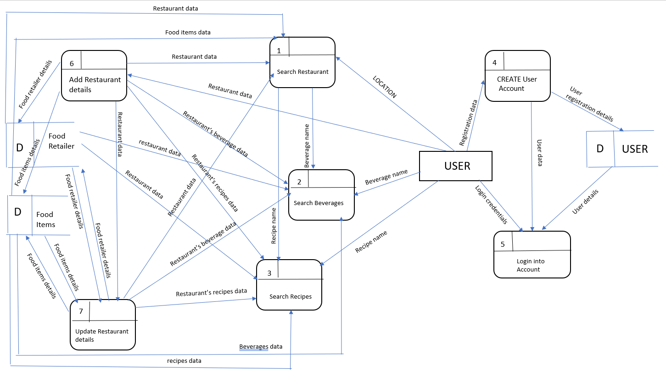
Data Flow Diagram - Physical
PRESENTED BY
- ASMA

Slide 12
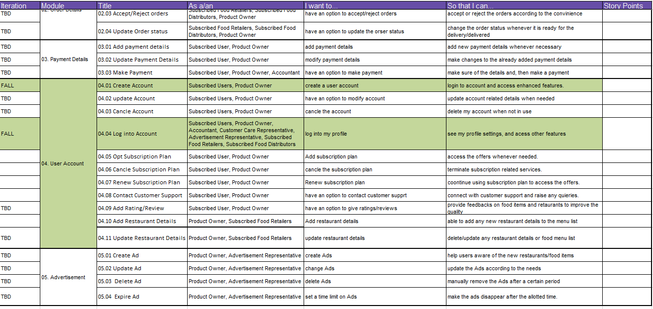
FUNCTIONAL REQUIREMENTS
PRESENTED BY
- JIGAR

Slide 13
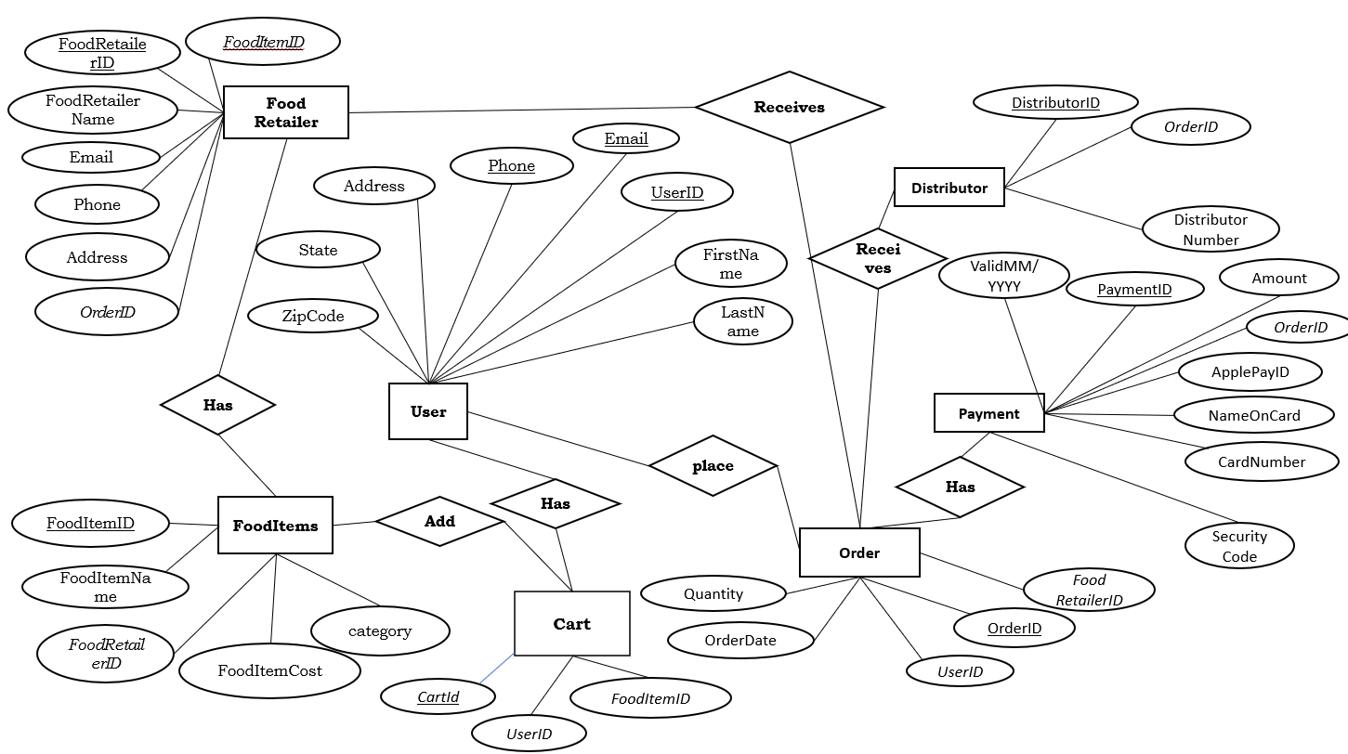
Conceptual ER Diagram
PRESENTED BY
- MURALI

Slide 14
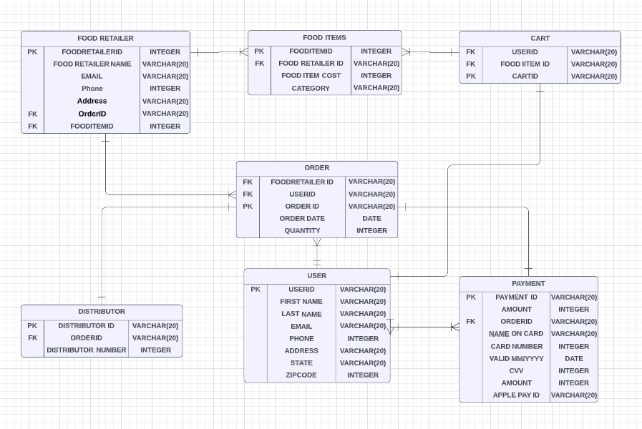
LOGICAL ER Diagram
PRESENTED BY
- MURALI

Slide 15
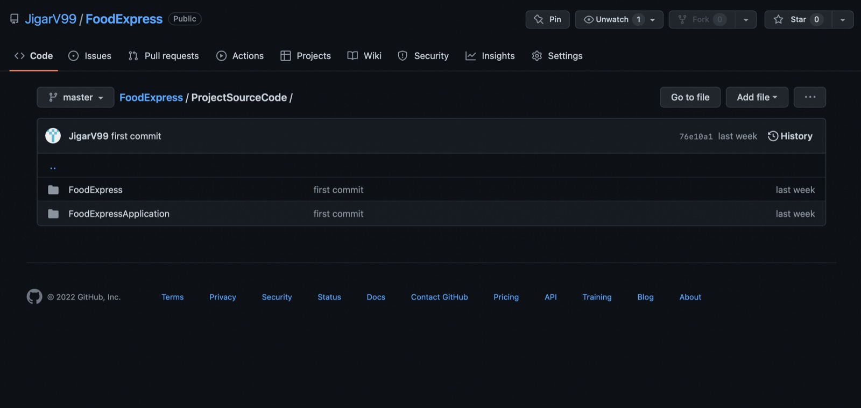
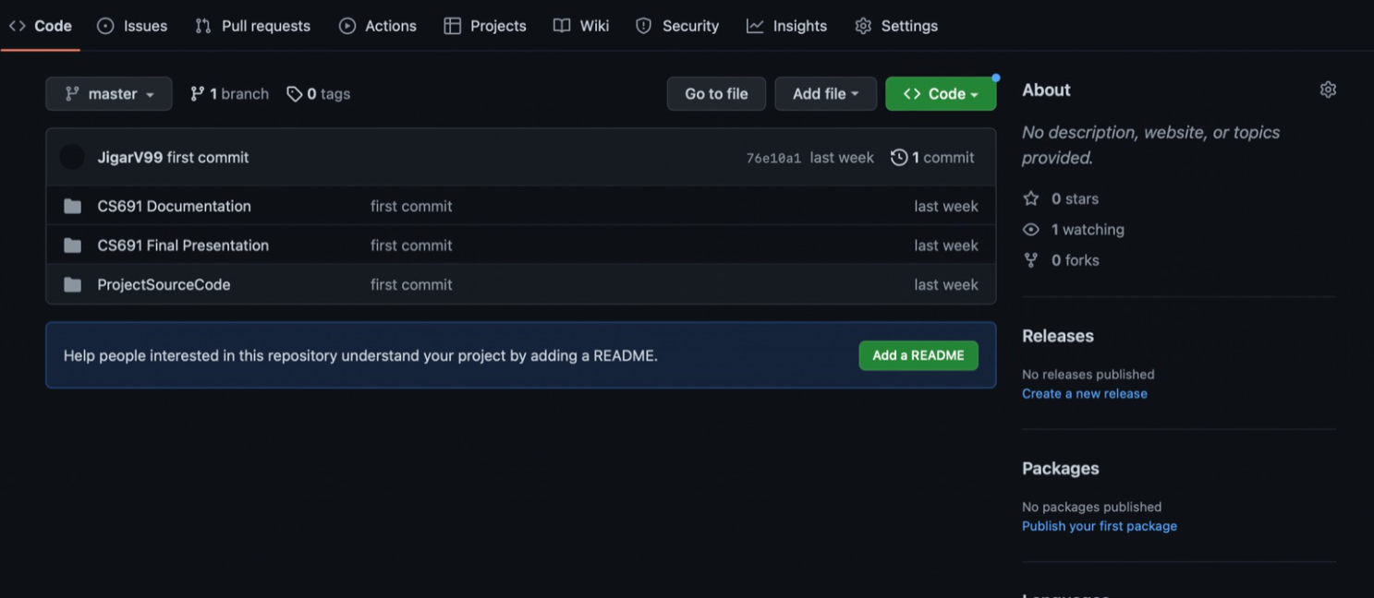
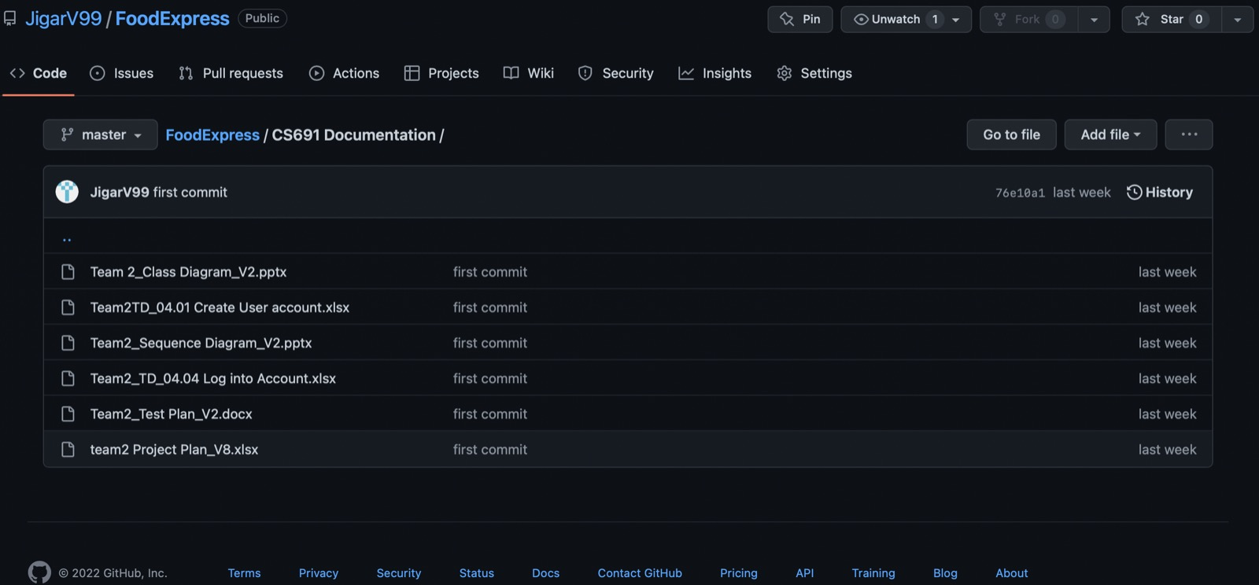
PROJECT SOURCE CODE
PRESENTED BY
JIGAR

Slide 16
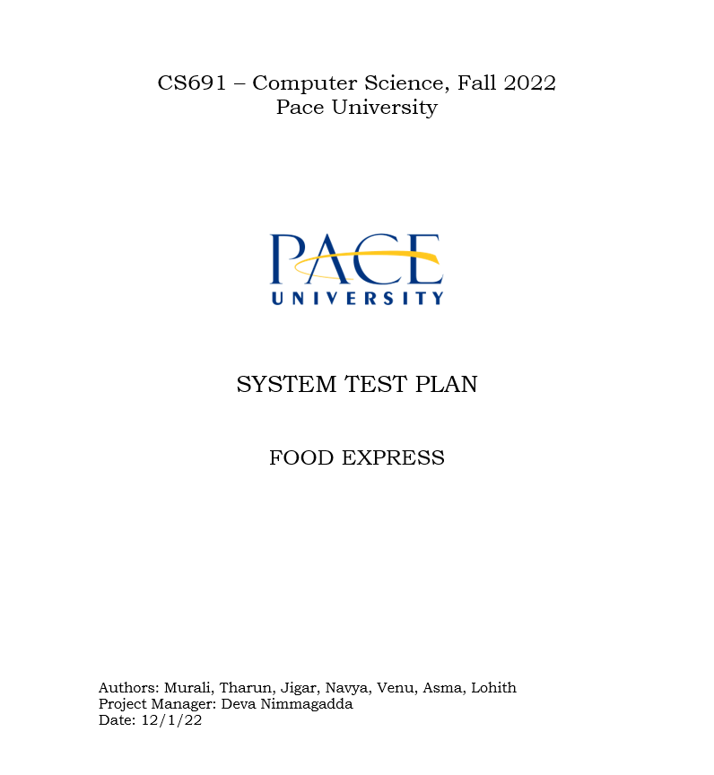
TEST PLAN
PRESENTED BY
DEVA

Slide 17
THANK YOU

